Slide 1
AP Biology Exam Format
With question specific Tips!

Slide 2
Format
Exam length: 3 hours
90 mins: multiple choice (63) & Grid-in (6)
Counts for 50% of total mark
10 min reading/planning period
90 mins: free response (8)
2 long answer: 1 lab/data based (20 mins for each, 25%)
6 short answer: paragraph response (6 mins for each, 25%)
no bullet points or diagrams – unless specifically asked for!

Slide 3
Multiple choice
Read questions carefully
Eliminate any directly wrong answers
Watch for negative/reverse questions (e.g. except, never, does not etc.)
Approximately 45-60 sec per question

Slide 4
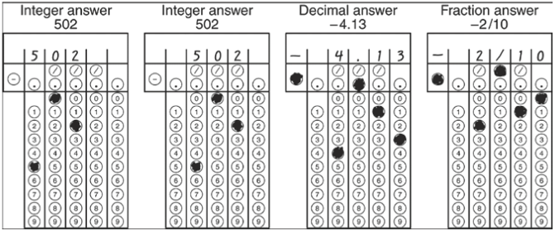
Grid-In
Read question carefully for rounding
Add value in top row
Bubble in value as well
Be sure to use decimals, negative signs or dashes if necessary

Slide 5
Reading period
Use it!!!! All of it!!!
Read over the free response questions and plan your answers

Slide 6
Free response
Use format: claim, evidence and reasoning
Answer question (claim)
Explain why using evidence
Final statement to circle back to claim
NO bullet points!!
No diagrams unless specifically asked for, or if references to in your answer
Define each and every scientific term you use
No marks are subtracted for wrong information

Slide 7
Experiment design questions
Hypothesis: “if…than…”
Variables: independent and dependent
Controls: “controls are…”
Explain what data you will collect and how you will measure it
Materials
Procedure
Analysis: how you will graph the data and analyze it
Conclusion: what you expect to happen & why, compare it back to your hypothesis

Slide 8
Graphing questions
Most marks will come from proper set up
Accurate & appropriate title
Labelled axis with equal increments
Name and units for each axis
Smooth curve; if more than one line on graph label each line – do not make a legend

Slide 9
Reminders…
As your studying: keep track of trends
Topics consistently getting wrong
Types of questions consistently getting wrong
Random questions
Mental strength : push past a question you don’t know, You will know the rest – I promise!!

Slide 10
What’s not on the Exam?
Names, molecular structures, and specific effects of plant hormones
Details of fossil dating methods
Names and dates of extinction events
Steps in the Calvin cycle, the structure of the molecules and the names of enzymes (EXCEPT for ATP synthase)
Steps in glycolysis and the Krebs cycle
Names of the specific electron carriers in the ETC
Names of specific stages of embryonic development
Genetic code
Names and phases of mitosis
Epistasis and pleiotropy
Details of sexual reproduction cycles in plants and animals
Specific mechanisms of diseases and action of drugs
Details of communications and community behavioral systems
Types of nervous systems, development of the human nervous system, details of the various structures and features of the brain parts, and details of specific neurologic processes
Molecular structure of specific nucleotides, chlorophyll, amino acids, lipids, and carbohydrate polymers
Functions of smooth ER in specialized cells
Specific examples of how lysosomes carry out intracellular digestion
Specific symbiotic interactions
•

